Slide 1

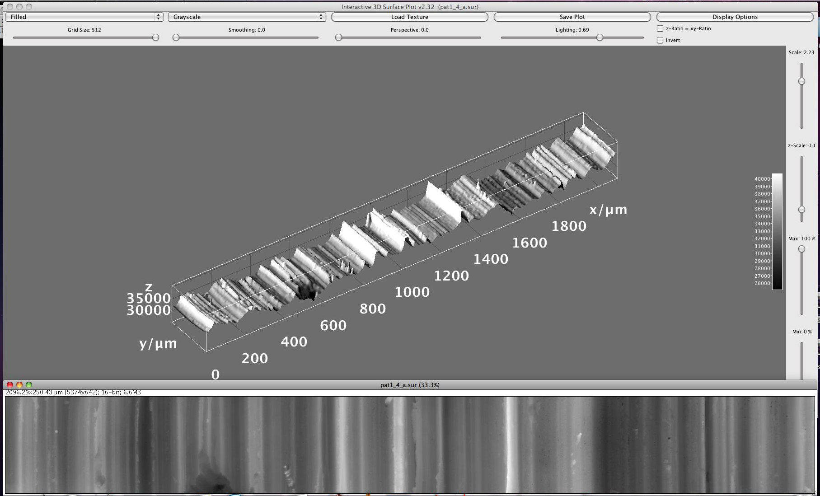


Hands-on Introduction to R

Slide 2
Outline
Analysis of variance
Post Hoc Testing
Linear regression
Fit diagnostics
Re-cap and Questions

Slide 3
Analysis of Variance
Standard hypothesis testing is great for comparing one or two sample means.
What is we have more than two statistics to compare?
Use analysis of variance (ANOVA)
H₀ for ANOVA
The values being compared are not statistically different at the (1-α)×100% level of confidence
H_{a} for ANOVA
At least one of the values being compared is statically distinct.

Slide 4
Example
Consider the shotgun spread data (square-root area) as a function of range below:
10 feet
20 feet
30 feet
40 feet
50 feet
2.60, 3.35, 3.33, 3.06, 3.38, 3.85, 3.01, 3.02, 3.29, 3.00, 3.20, 3.11
6.84, 6.32, 6.96, 5.85, 5.95, 6.29, 5.57, 5.00, 5.42, 5.73, 5.29, 5.10
6.51, 6.72, 8.24, 7.38, 9.84, 9.42, 8.09, 6.80, 7.95, 8.62, 8.41, 8.62, 9.23
10.28, 11.47, 14.10, 12.54, 16.13, 11.03, 10.81, 10.19, 13.01, 11.17, 11.33, 9.35
11.80, 13.74, 5.18, 20.13, 16.94, 14.09, 16.07, 14.90, 17.47, 14.21, 13.13, 11.93
Use ANOVA to test for evidence of a significant difference between at least one of the treatment means

Slide 5
Example
# Data (responses)
y <- c(
2.60,3.35,3.33,3.06,3.38,3.85,3.01,3.02,3.29,3.00,3.20,3.11,
6.84,6.32,6.96,5.85,5.95,6.29,5.57,5.00,5.42,5.73,5.29,5.10,
6.51,6.72,8.24,7.38,9.84,9.42,8.09,6.80,7.95,8.62,8.41,8.62,9.23,
10.28,11.47,14.10,12.54,16.13,11.03,10.81,10.19,13.01,11.17,11.33,9.35,
11.80,13.74, 5.18,20.13,16.94,14.09,16.07,14.90,17.47,14.21,13.13,11.93
)
# Treatment labels for each data point
lbl <- c(
10, 10, 10, 10, 10, 10, 10, 10, 10, 10, 10, 10,
20, 20, 20, 20, 20, 20, 20, 20, 20, 20, 20, 20,
30, 30, 30, 30, 30, 30, 30, 30, 30, 30, 30, 30, 30,
40, 40, 40, 40, 40, 40, 40, 40, 40, 40, 40, 40,
50, 50, 50, 50, 50, 50, 50, 50, 50, 50, 50, 50
)
# Box plots to visually compare treatments:
boxplot(y ~ as.factor(lbl), range=0 )
# Quick look at the treatment means we will test
tapply(y, lbl, mean)
# R can handle all the ANOVA calculations automatically:
fit <- aov(y ~ as.factor(lbl))
summary(fit)

Slide 6
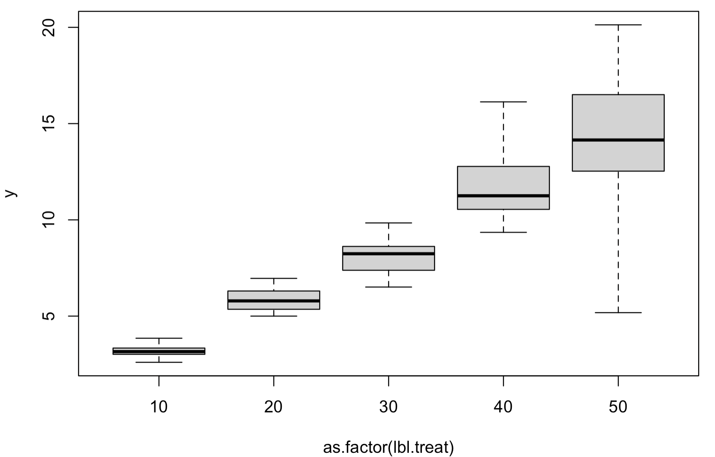
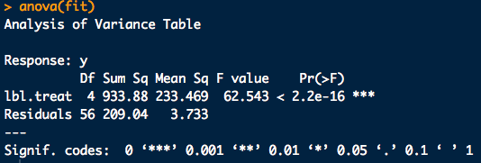
Example

Slide 7
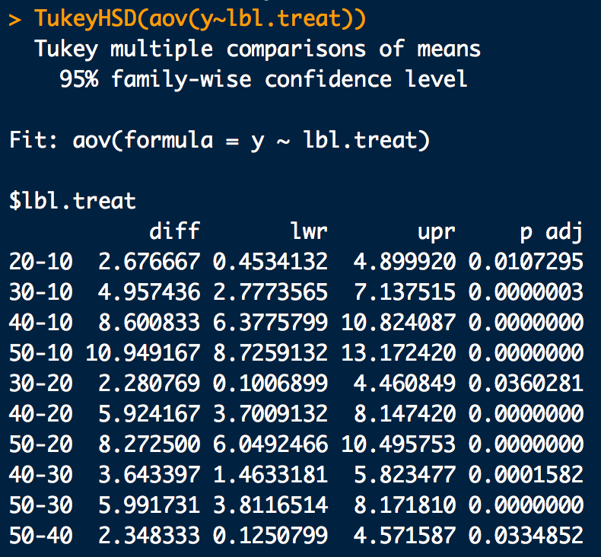
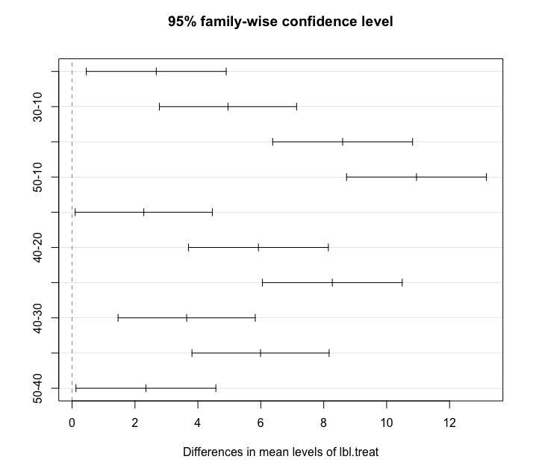
Another Tukey HSD Example
# Find a significant result from ANOVA? Do a Tukey HSD:
fit.tukey <- TukeyHSD(fit)
fit.tukey # Tukey test outputs
plot(fit.tukey) # Graphical version

Slide 8
Basic Linear Regression
y
x

Slide 9
Example: Basic Linear Regression
Consider the Manganese and Zirconium content for sets of different kinds of glass bottles^{Curran}
Manganese Data (Mn)
56.1, 53.8, 58.7, 54.6, 58.6, 56.8, 54.6, 59.2, 54.9, 61.1, 59.4, 54.9, 58.7, 55.3, 61.7, 59.7, 56.3, 59.8, 53.6, 60.6,
58.6, 52.5, 61.2, 54, 61.7, 59, 53.9, 61.5, 57.4, 60.5, 65.8, 55, 60.8, 56.4, 63.4, 65.4, 55.9, 59.7, 56.9, 63.4,
65.2, 55.1, 61.6, 58.7, 63.8, 64.7, 56.6, 60.9, 57.8, 63.5, 64.1, 57.4, 61.2, 57.4, 65, 64.8, 56.7, 60.3, 57.6, 64.3,
66, 57.5, 61.5, 58, 65.3, 67.2, 56.3, 60.3, 57.4, 66.4, 67.9, 55.2, 63, 58, 65.2, 66.1, 57.7, 63.3, 58.7, 64,
52.7, 43.5, 49.8, 47, 52.1, 50.2, 41.8, 48.6, 44.9, 51.1, 50.8, 45.2, 49, 44.6, 50.9, 52.3, 43.3, 48.8, 45.5, 52,
65.1, 57.4, 64.5, 59.3, 66.5, 66.6, 56.8, 62.6, 59, 67.8, 65.7, 56.6, 62.4, 57.9, 67.2, 64.9, 52.4, 61.9, 57.8, 63.9
Zirconium Data (Zr)
77.4, 71.6, 78.2, 75.3, 83.9, 79.2, 74.6, 78.9, 80.2, 90.2, 77.6, 70.3, 74.7, 72.4, 83.4, 78.3, 71.4, 79.4, 78.0, 82.7,
85.8, 80.0, 90.8, 88.0, 99.2, 85.1, 70.3, 80.0, 77.7, 84.8, 86.3, 70.2, 80.6, 79.9, 86.8, 84.5, 71.4, 79.6, 78.4, 86.8,
93.3, 81.4, 91.4, 86.5, 99.0, 100.9, 88.0, 95.1, 94.4, 109.4, 89.5, 79.3, 87.1, 85.3, 98.5, 100.4, 83.7, 89.5, 93.8, 106.7,
102.6, 85.9, 91.7, 93.4, 109.4, 111.4, 93.4, 101.1, 103.6, 118.7, 92.9, 77.1, 84.1, 84.0, 100.1, 97.5, 82.9, 94.6, 91.4, 102.2,
63.1, 51.2, 59.1, 57.0, 65.6, 74.0, 60.1, 70.9, 68.8, 79.8, 56.6, 50.0, 58.3, 56.2, 69.5, 67.3, 55.6, 64.2, 63.9, 75.4,
101.5, 84.0, 96.5, 91.0, 109.6, 81.4, 70.6, 81.1, 79.7, 91.0, 116.6, 94.2, 109.8, 108.5, 125.7, 81.5, 67.8, 80.8, 77.9, 90.9

Slide 10
Example: Basic Linear Regression
Compute a best fit line to the data of Mn vs Zr and report:
a. The slope coefficient,
b. The intercept coefficient,
c. Is the slope coefficient significant at, at least the 95% level of confidence?
d. Is the intercept coefficient significant at, at least the 95% level of confidence?
e. The standard error of the residuals,
f. The Adjusted R-squared correlation coefficient

Slide 11
Example: Basic Linear Regression
# Load the data Mn = x, Zr = y:
x <- c(
56.1, 53.8, 58.7, 54.6, 58.6, 56.8, 54.6, 59.2, 54.9, 61.1,
59.4, 54.9, 58.7, 55.3, 61.7, 59.7, 56.3, 59.8, 53.6, 60.6,
58.6, 52.5, 61.2, 54, 61.7, 59, 53.9, 61.5, 57.4, 60.5,
65.8, 55, 60.8, 56.4, 63.4, 65.4, 55.9, 59.7, 56.9, 63.4,
65.2, 55.1, 61.6, 58.7, 63.8, 64.7, 56.6, 60.9, 57.8, 63.5,
64.1, 57.4, 61.2, 57.4, 65, 64.8, 56.7, 60.3, 57.6, 64.3,
66, 57.5, 61.5, 58, 65.3, 67.2, 56.3, 60.3, 57.4, 66.4,
67.9, 55.2, 63, 58, 65.2, 66.1, 57.7, 63.3, 58.7, 64,
52.7, 43.5, 49.8, 47, 52.1, 50.2, 41.8, 48.6, 44.9, 51.1,
50.8, 45.2, 49, 44.6, 50.9, 52.3, 43.3, 48.8, 45.5, 52,
65.1, 57.4, 64.5, 59.3, 66.5, 66.6, 56.8, 62.6, 59, 67.8,
65.7, 56.6, 62.4, 57.9, 67.2, 64.9, 52.4, 61.9, 57.8, 63.9
)
y <- c(
77.4, 71.6, 78.2, 75.3, 83.9, 79.2, 74.6, 78.9, 80.2, 90.2,
77.6, 70.3, 74.7, 72.4, 83.4, 78.3, 71.4, 79.4, 78.0, 82.7,
85.8, 80.0, 90.8, 88.0, 99.2, 85.1, 70.3, 80.0, 77.7, 84.8,
86.3, 70.2, 80.6, 79.9, 86.8, 84.5, 71.4, 79.6, 78.4, 86.8,
93.3, 81.4, 91.4, 86.5, 99.0, 100.9, 88.0, 95.1, 94.4, 109.4,
89.5, 79.3, 87.1, 85.3, 98.5, 100.4, 83.7, 89.5, 93.8, 106.7,
102.6, 85.9, 91.7, 93.4, 109.4, 111.4, 93.4, 101.1, 103.6, 118.7,
92.9, 77.1, 84.1, 84.0, 100.1, 97.5, 82.9, 94.6, 91.4, 102.2,
63.1, 51.2, 59.1, 57.0, 65.6, 74.0, 60.1, 70.9, 68.8, 79.8,
56.6, 50.0, 58.3, 56.2, 69.5, 67.3, 55.6, 64.2, 63.9, 75.4,
101.5, 84.0, 96.5, 91.0, 109.6, 81.4, 70.6, 81.1, 79.7, 91.0,
116.6, 94.2, 109.8, 108.5, 125.7, 81.5, 67.8, 80.8, 77.9, 90.9
)

Slide 12
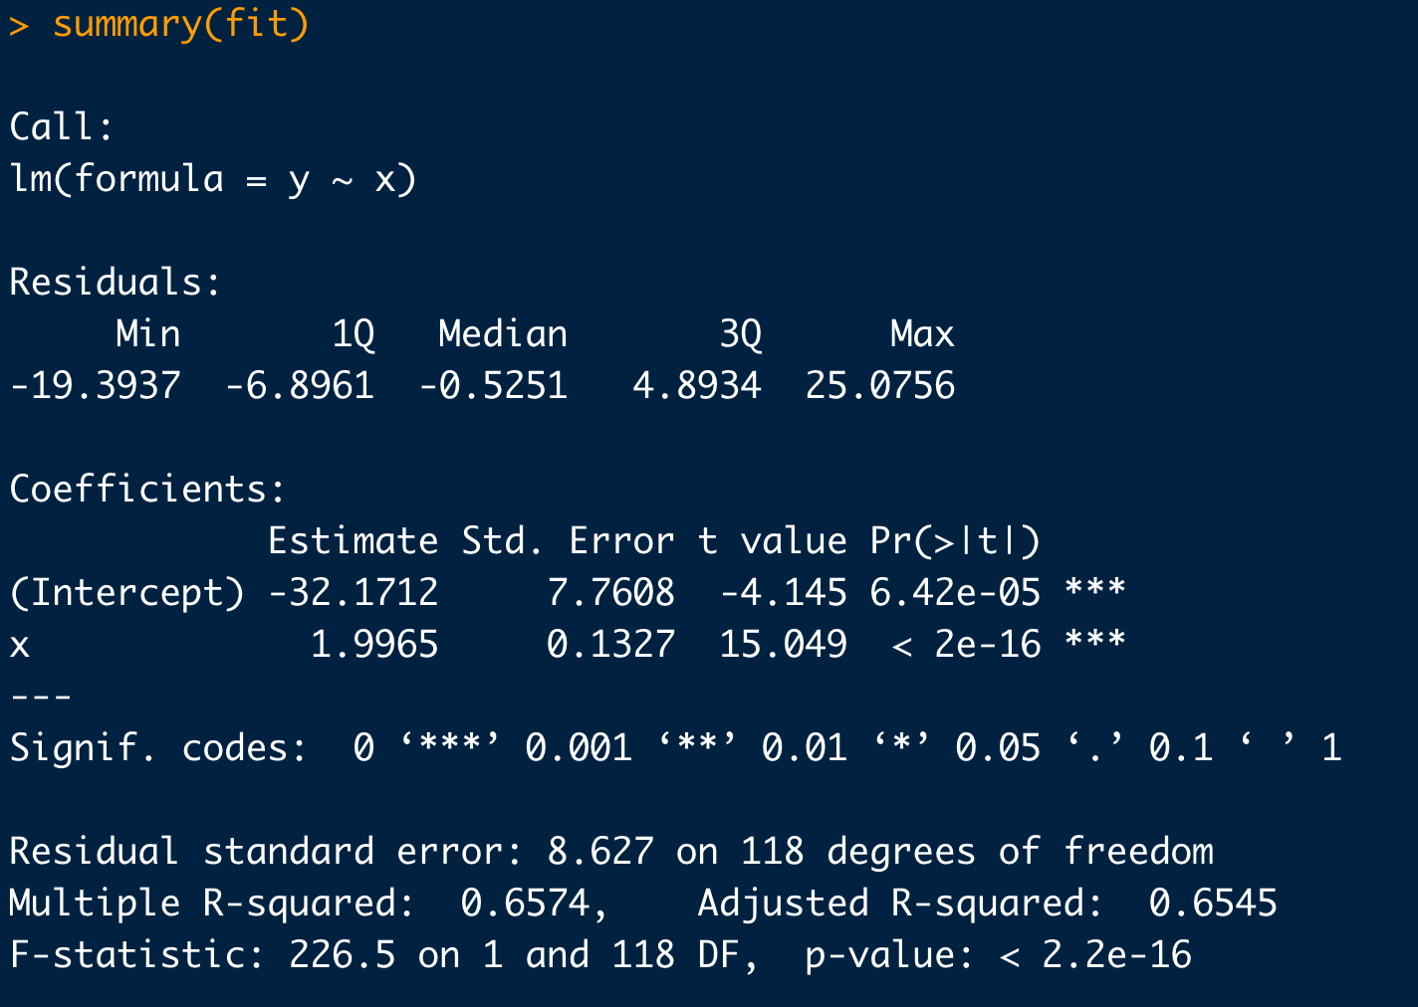
Example: Basic Linear Regression
# Take a look at your data first:
plot(x,y)
# Simple linear regression:
fit <- lm(y ~ x)
summary(fit)
# Plot in your regression line:
plot(x,y)
abline(fit)
slope is significant at 95%
intercept is significant at 95%
Adjusted R²

Slide 13
Example: Basic Linear Regression
# Check your regression diagnostics (i.e. the behavior of the residuals):
eps <- residuals(fit)
hist(eps)
# Do the residuals look N(0, eps)-ish?:
qqnorm(eps)
qqline(eps)

